Slide 1
Direct Parameter Recentering & Rescaling
Doug Hemken

Slide 2
The Problem (recap)
Re-calculating coefficients for models
As if the data have been recentered, rescaled, or both
Without actually transforming the data

Slide 3
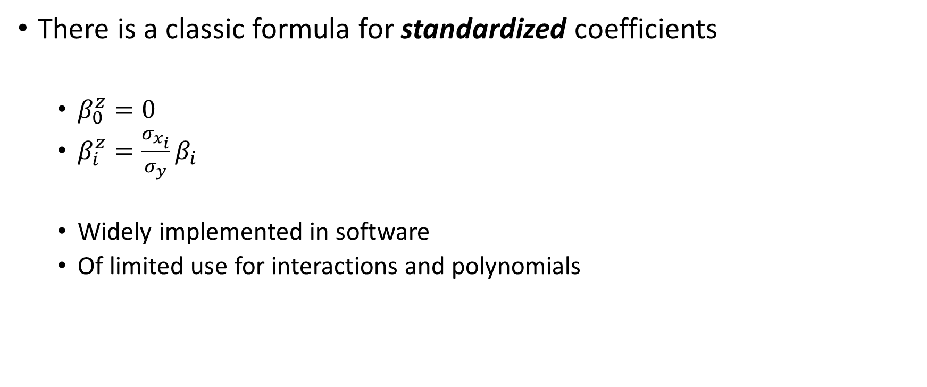
The Problem (recap)
There is a classic formula for standardized coefficients
$β_{0}^{z}=0$
$β_{i }^{z}=\frac{σ_{x_{i}}}{σ_{y}}β_{i}$
Widely implemented in software
Of limited use for interactions and polynomials

Slide 4
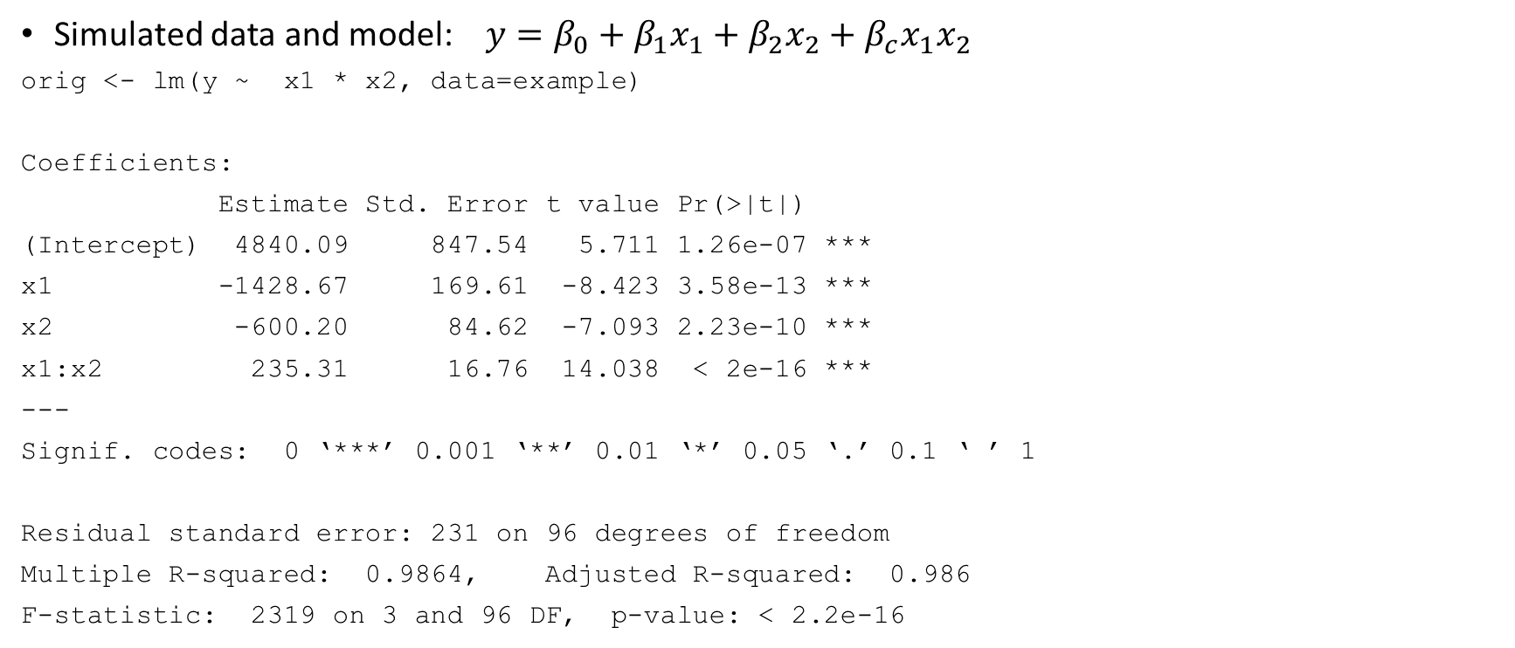
Example: set up
Simulated data and model: $y=β_{0}+β_{1}x_{1}+β_{2}x_{2}+β_{c}x_{1}x_{2}$
orig <- lm(y ~ x1 * x2, data=example)
Coefficients:
Estimate Std. Error t value Pr(>|t|)
(Intercept) 4840.09 847.54 5.711 1.26e-07 ***
x1 -1428.67 169.61 -8.423 3.58e-13 ***
x2 -600.20 84.62 -7.093 2.23e-10 ***
x1:x2 235.31 16.76 14.038 < 2e-16 ***
---
Signif. codes: 0 ‘***’ 0.001 ‘**’ 0.01 ‘*’ 0.05 ‘.’ 0.1 ‘ ’ 1
Residual standard error: 231 on 96 degrees of freedom
Multiple R-squared: 0.9864, Adjusted R-squared: 0.986
F-statistic: 2319 on 3 and 96 DF, p-value: < 2.2e-16

Slide 5
Example: compare coefficients
Original Classic Formula Recalculated
(Intercept) 4840.09 0.00 -0.04
x1 -1428.67 -1.37 0.89
x2 -600.20 -0.27 0.26
x1:x2 235.31 0.23 0.20

Slide 6
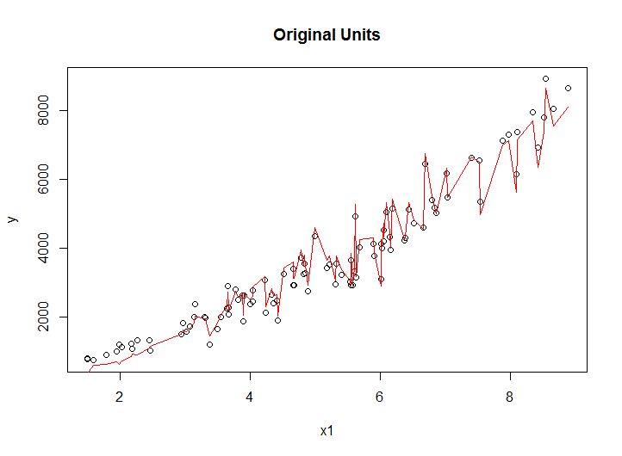
Two graphs

Slide 7
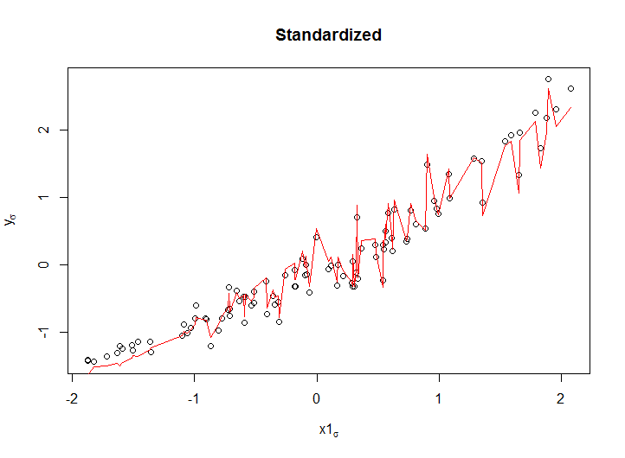
Two graphs

Slide 8
Of note
Unchanged
Relative positions of data points
Relative position of predictions
Changed
x- and y- axes
Change of basis

Slide 9
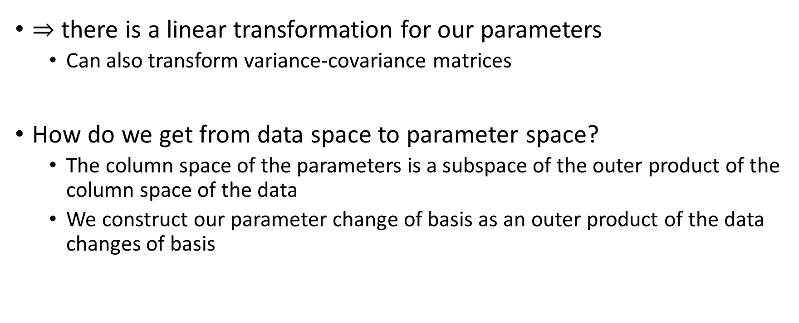

Change of basis, data Change of basis, parameters
there is a linear transformation for our parameters
Can also transform variance-covariance matrices
How do we get from data space to parameter space?
The column space of the parameters is a subspace of the outer product of the column space of the data
We construct our parameter change of basis as an outer product of the data changes of basis

Slide 10




Single variable
$$y=β_{0}+β_{1}x$$
$$Y=Xβ$$
Recenter, $x_{δ}=x−μ$
Let $C=\left[\begin{matrix}1 & μ \\ 0 & 1\end{matrix}\right]$
Rescale, $x_{σ}=x/σ$
Let $S=\left[\begin{matrix}1 & 0 \\ 0 & σ\end{matrix}\right]$
Standardize
$β^{δ}=C×β$
$β^{σ}=S×β$
$β^{z}=S×C×β$

Slide 11

Two variables, re-centering
$y=β_{0}+β_{1}x_{1}$ $+β_{2}x_{2}$ $+β_{3}x_{1}x_{2}$
$β^{δ}=\left(C_{2}⊗C_{1}\right)×β=\left[\begin{matrix}1 & μ_{1} & μ_{2} & μ_{1}μ_{2} \\ 0 & 1 & 0 & μ_{2} \\ 0 & 0 & 1 & μ_{1} \\ 0 & 0 & 0 & 1\end{matrix}\right]β$

Slide 12

Two variables, re-scaling
$y=β_{0}+β_{1}x_{1}$ $+β_{2}x_{2}$ $+β_{3}x_{1}x_{2}$
$β^{σ}=\left(S_{2}⊗S_{1}\right)×β=\left[\begin{matrix}1 & 0 & 0 & 0 \\ 0 & σ_{1} & 0 & 0 \\ 0 & 0 & σ_{2} & 0 \\ 0 & 0 & 0 & σ_{1}σ_{2}\end{matrix}\right]β$

Slide 13
Implementation
Consider
Less-than-full factorial models
Missing lower-order terms (no-intercept, nested terms)
Polynomial terms, collecting terms
Untransformed variables, direct sums
Category coding/contrasts
Progress
All of the pieces, but not fully integrated yet.

Slide 14
Advantages
Requires only sufficient statistics, not the full data
Reduces the total computation
Reduces numerical error

Slide 15
On numerical error
Simulation study
Predicted values from recentered models should be unchanged
Error measured as normed difference in predicted values
3-way model, appropriate to the data
100,000 simulations, each model N=100
The same (recentered) data is used to calculate predicted values
One model is re-estimated
The other has directly transformed coefficients

Slide 16
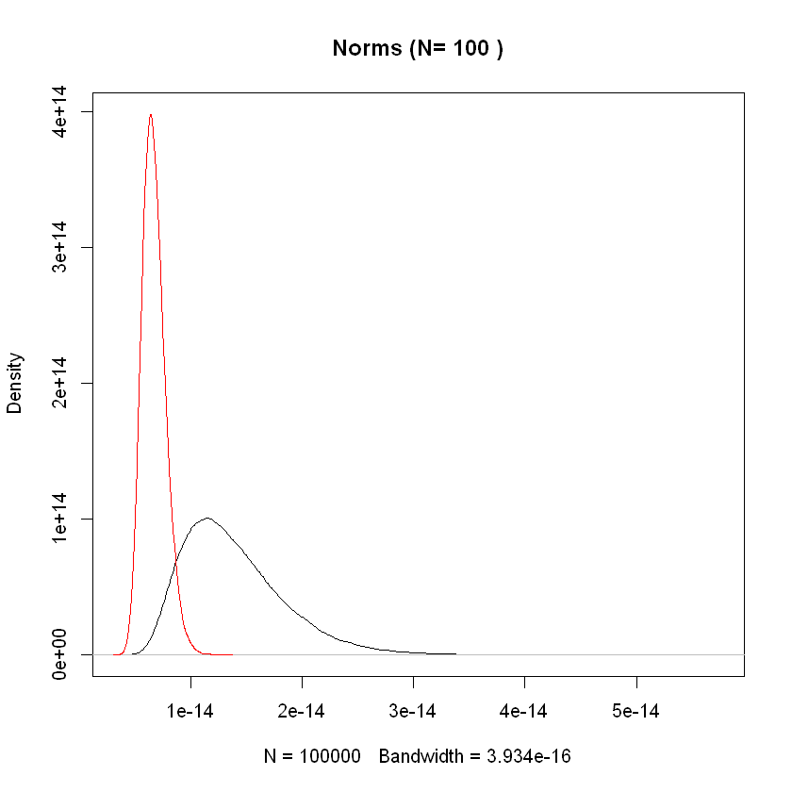
Kernel density of normed errors (red=direct, black=re-estimate)

